Slide 1
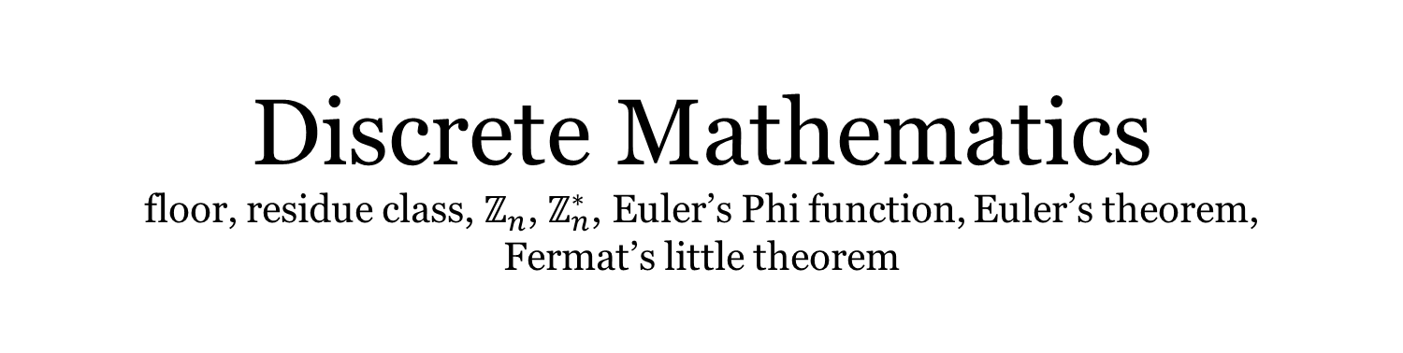
Discrete Mathematics floor, residue class, $ℤ_{n}$, $ℤ_{n}^{∗}$, Euler’s Phi function, Euler’s theorem, Fermat’s little theorem
Liangfeng Zhang
School of Information Science and Technology
ShanghaiTech University

Slide 2
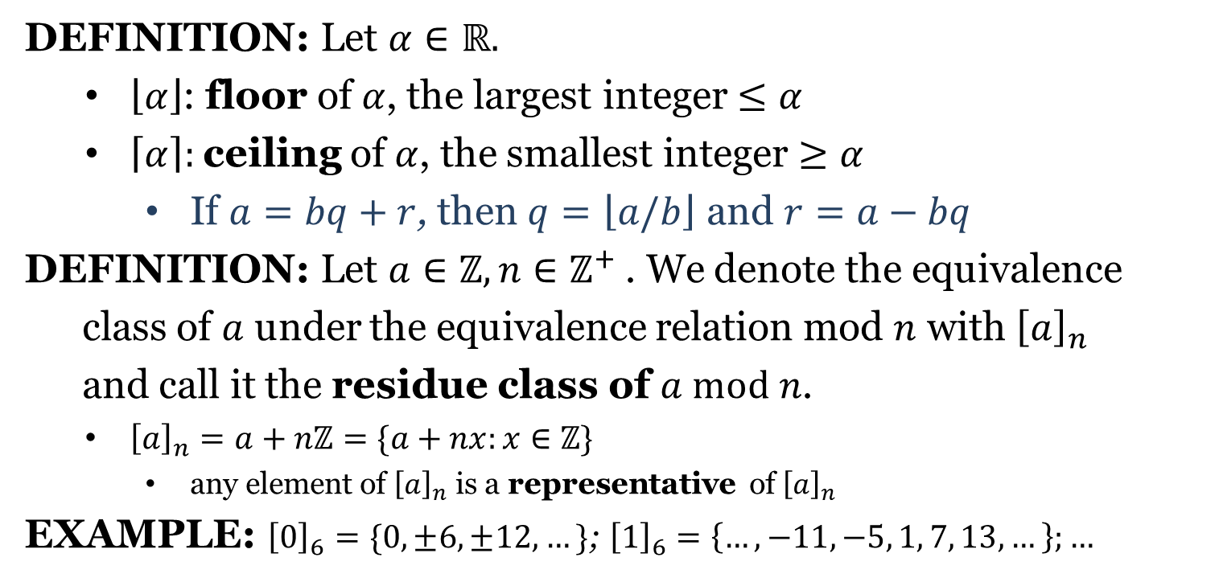
Residue Class
DEFINITION: Let $α∈ℝ.$
$\left\lfloor α\right\rfloor$: floor of $α$, the largest integer $≤α$
$\left\lceil α\right\rceil :$ceiling of $α$, the smallest integer $≥α$
If $a=bq+r$, then $q=\left\lfloor a/b\right\rfloor$ and $r=a−bq$
DEFINITION: Let $a∈ℤ,n∈ℤ^{+}$. We denote the equivalence
class of $a$ under the equivalence relation mod $n$ with ${\left[a\right]}_{n}$
and call it the residue class of $a mod n$.
${\left[a\right]}_{n}=a+nℤ=\{a+nx:x∈ℤ\}$
any element of ${\left[a\right]}_{n}$ is a representative of ${\left[a\right]}_{n}$
EXAMPLE: ${\left[0\right]}_{6}=\{0,±6,±12,…\}$; ${\left[1\right]}_{6}=\left\{…, −11, −5, 1, 7, 13, …\right\};…$

Slide 3
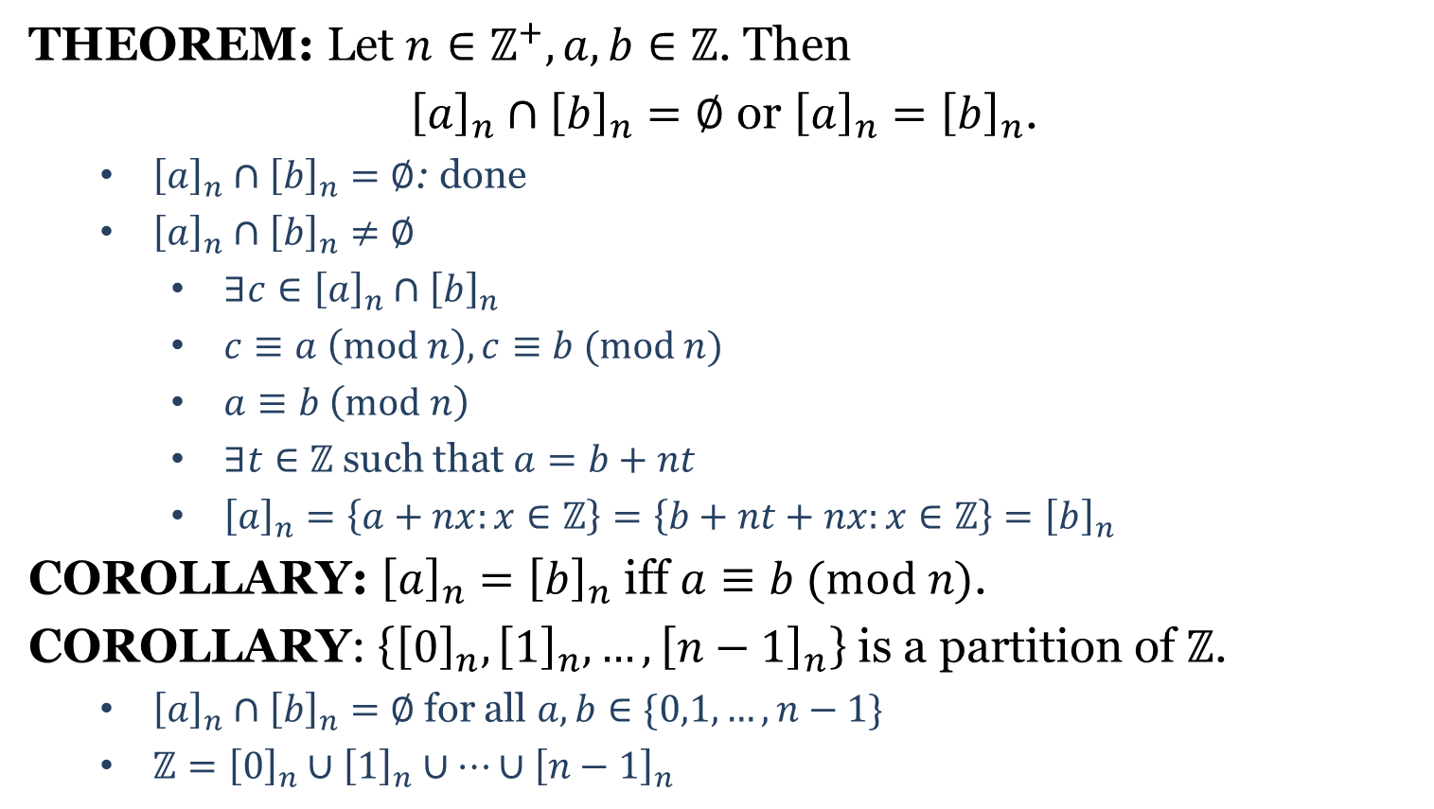
Residue Class
THEOREM: Let $n∈ℤ^{+}, a,b∈ℤ$. Then
${\left[a\right]}_{n}∩{\left[b\right]}_{n}=∅$ or ${\left[a\right]}_{n}={\left[b\right]}_{n}$.
${\left[a\right]}_{n}∩{\left[b\right]}_{n}=∅$: done
${\left[a\right]}_{n}∩{\left[b\right]}_{n}≠∅$
$∃c∈{\left[a\right]}_{n}∩{\left[b\right]}_{n}$
$c≡a \left(mod n\right), c≡b (mod n)$
$a≡b \left(mod n\right)$
$∃t∈ℤ$ such that $a=b+nt$
${\left[a\right]}_{n}=\left\{a+nx:x∈ℤ\right\}=\left\{b+nt+nx:x∈ℤ\right\}={\left[b\right]}_{n}$
COROLLARY: ${\left[a\right]}_{n}={\left[b\right]}_{n}$ iff $a≡b (mod n)$.
COROLLARY: $\left\{{\left[0\right]}_{n},{\left[1\right]}_{n},…,{\left[n−1\right]}_{n}\right\}$ is a partition of $ℤ$.
${\left[a\right]}_{n}∩{\left[b\right]}_{n}=∅$ for all $a,b∈\{0,1,…,n−1\}$
$ℤ={\left[0\right]}_{n}∪{\left[1\right]}_{n}∪⋯∪{\left[n−1\right]}_{n}$

Slide 4
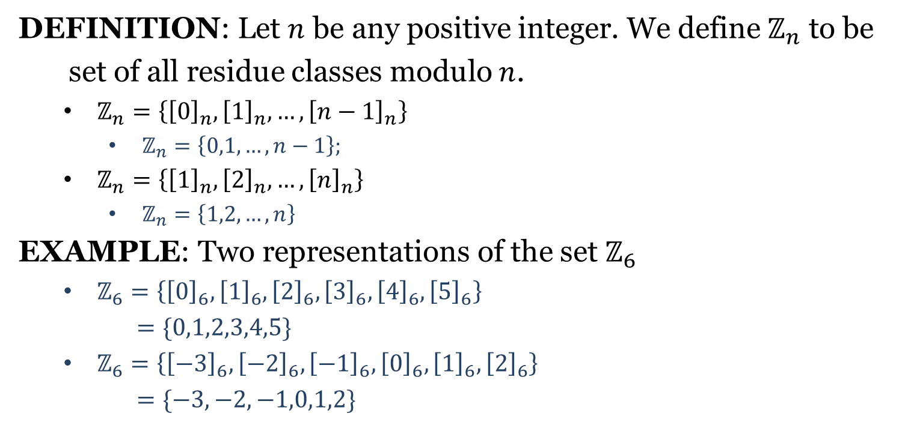

$$ℤ_{n}$$
DEFINITION: Let $n$ be any positive integer. We define $ℤ_{n}$ to be
set of all residue classes modulo $n$.
$ℤ_{n}=\left\{{\left[0\right]}_{n}, {\left[1\right]}_{n}, …, {\left[n−1\right]}_{n}\right\}$
$ℤ_{n}=\left\{0,1,…,n−1\right\};$
$ℤ_{n}=\left\{{\left[1\right]}_{n}, {\left[2\right]}_{n}, …, {\left[n\right]}_{n}\right\}$
$ℤ_{n}=\left\{1,2,…,n\right\}$
EXAMPLE: Two representations of the set $ℤ_{6}$
$ℤ_{6}=\left\{{\left[0\right]}_{6},{\left[1\right]}_{6},{\left[2\right]}_{6},{\left[3\right]}_{6},{\left[4\right]}_{6},{\left[5\right]}_{6}\right\}$
$=\{0,1,2,3,4,5\}$
$ℤ_{6}=\left\{{\left[−3\right]}_{6},{\left[−2\right]}_{6},{\left[−1\right]}_{6},{\left[0\right]}_{6},{\left[1\right]}_{6},{\left[2\right]}_{6}\right\}$
$=\{−3,−2,−1,0,1,2\}$

Slide 5
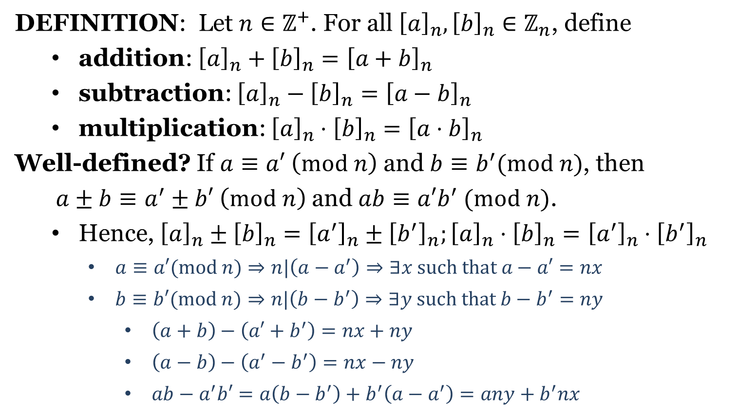

$ℤ_{n}$
DEFINITION: Let $n∈ℤ^{+}$. For all ${\left[a\right]}_{n},{\left[b\right]}_{n}∈ℤ_{n}$, define
addition: ${\left[a\right]}_{n}+{\left[b\right]}_{n}={\left[a+b\right]}_{n}$
subtraction: ${\left[a\right]}_{n}−{\left[b\right]}_{n}={\left[a−b\right]}_{n}$
multiplication: ${\left[a\right]}_{n}⋅{\left[b\right]}_{n}={\left[a⋅b\right]}_{n}$
Well-defined? If $a≡a′ \left(mod n\right)$ and $b≡b^{′}(mod n)$, then
$a±b≡a^{′}±b′ \left(mod n\right)$ and $ab≡a′b^{′} (mod n)$.
Hence, ${\left[a\right]}_{n}±{\left[b\right]}_{n}={\left[a^{′}\right]}_{n}±{\left[b^{′}\right]}_{n};{\left[a\right]}_{n}⋅{\left[b\right]}_{n}={\left[a^{′}\right]}_{n}⋅{\left[b^{′}\right]}_{n}$
$a≡a′(mod n)⇒n|\left(a−a^{′}\right)⇒∃x such that a−a′=nx$
$b≡b′(mod$ $n)⇒n|\left(b−b^{′}\right)⇒∃y such that b−b^{′}=ny$
$\left(a+b\right)−\left(a′+b^{′}\right)=nx+ny$
$\left(a−b\right)−\left(a^{′}−b^{′}\right)=nx−ny$
$ab−a^{′}b′=a\left(b−b^{′}\right)+b^{′}\left(a−a^{′}\right)=any+b^{′}nx$

Slide 6
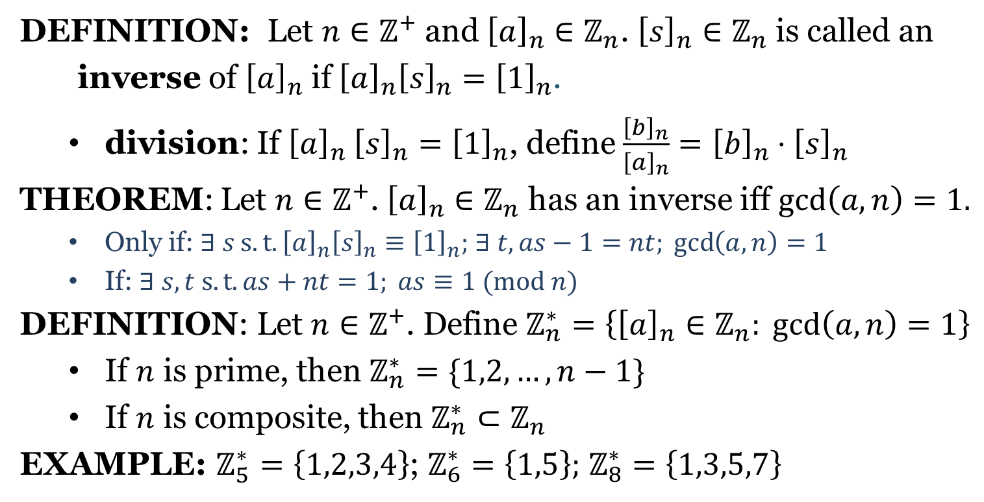

$$ℤ_{n}^{∗}$$
DEFINITION: Let $n∈ℤ^{+}$ and ${\left[a\right]}_{n}∈ℤ_{n}$. ${\left[s\right]}_{n}∈ℤ_{n}$ is called an
inverse of ${\left[a\right]}_{n}$ if ${\left[a\right]}_{n}{\left[s\right]}_{n}={\left[1\right]}_{n}$.
division: If ${\left[a\right]}_{n}$ ${\left[s\right]}_{n}={\left[1\right]}_{n}$, define $\frac{{\left[b\right]}_{n}}{{\left[a\right]}_{n}}={\left[b\right]}_{n}⋅{\left[s\right]}_{n}$
THEOREM: Let $n∈ℤ^{+}$. ${\left[a\right]}_{n}∈ℤ_{n}$ has an inverse iff $\gcd\left(a,n\right)=1.$
Only if: $∃ s s.t. {\left[a\right]}_{n}{\left[s\right]}_{n}≡{\left[1\right]}_{n};$ $∃ t, as−1=nt; \gcd\left(a,n\right)=1$
If: $∃ s,t s.t. as+nt=1; as≡1 (mod n)$
DEFINITION: Let $n∈ℤ^{+}$. Define $ℤ_{n}^{∗}=\left\{{\left[a\right]}_{n}∈ℤ_{n}: \gcd\left(a,n\right)=1\right\}$
If $n$ is prime, then $ℤ_{n}^{∗}=\{1,2,…,n−1\}$
If $n$ is composite, then $ℤ_{n}^{∗}⊂ℤ_{n}$
EXAMPLE: $ℤ_{5}^{∗}=\left\{1,2,3,4\right\}$; $ℤ_{6}^{∗}=\left\{1,5\right\};$ $ℤ_{8}^{∗}=\left\{1,3,5,7\right\}$

Slide 7
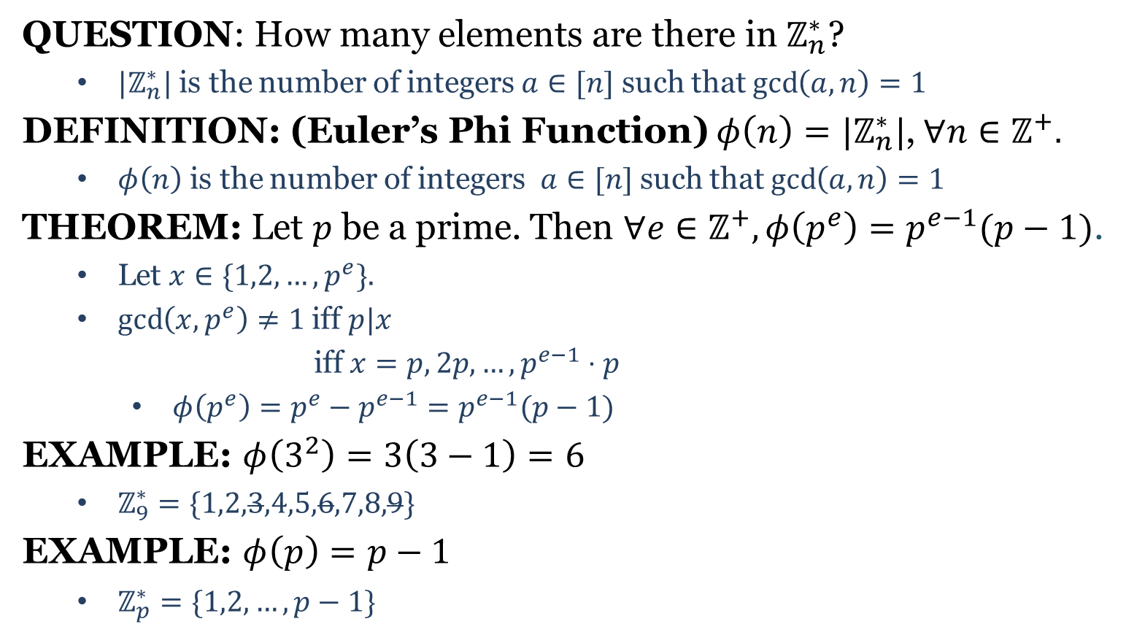
Euler’s Phi Function
QUESTION: How many elements are there in $ℤ_{n}^{∗}$?
$|ℤ_{n}^{∗}|$ is the number of integers $a∈[n]$ such that $\gcd\left(a,n\right)=1$
DEFINITION: (Euler’s Phi Function) $φ\left(n\right)=|ℤ_{n}^{∗}|$,$∀n∈ℤ^{+}.$
$φ\left(n\right)$ is the number of integers $a∈[n]$ such that $\gcd\left(a,n\right)=1$
THEOREM: Let $p$ be a prime. Then $∀e∈ℤ^{+},φ\left(p^{e}\right)=p^{e−1}(p−1)$.
Let $x∈\{1,2,…,p^{e}\}.$
$\gcd\left(x,p^{e}\right)≠1$ iff $p|x$
iff $x=p, 2p, …, p^{e−1}⋅p$
$φ\left(p^{e}\right)=p^{e}−p^{e−1}=p^{e−1}(p−1)$
EXAMPLE: $φ\left(3^{2}\right)=3\left(3−1\right)=6$
$ℤ_{9}^{∗}=\{1,2,3,4,5,6,7,8,9\}$
EXAMPLE: $φ\left(p\right)=p−1$
$ℤ_{p}^{∗}=\{1,2,…,p−1\}$

Slide 8
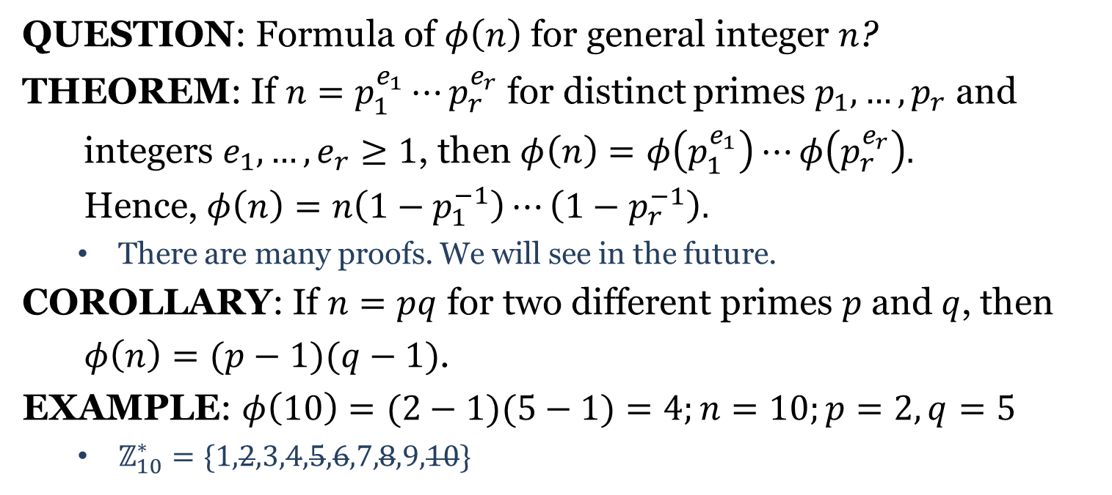
Euler’s Phi Function
QUESTION: Formula of $φ\left(n\right)$ for general integer $n$?
THEOREM: If $n=p_{1}^{e_{1}}⋯p_{r}^{e_{r}}$ for distinct primes $p_{1},…,p_{r}$ and
integers $e_{1},…,e_{r}≥1$, then $φ\left(n\right)=φ\left(p_{1}^{e_{1}}\right)⋯φ\left(p_{r}^{e_{r}}\right).$
Hence, $φ\left(n\right)=n\left(1−p_{1}^{−1}\right)⋯\left(1−p_{r}^{−1}\right).$
There are many proofs. We will see in the future.
COROLLARY: If $n=pq$ for two different primes $p$ and $q$, then
$φ\left(n\right)=(p−1)(q−1)$.
EXAMPLE: $φ\left(10\right)=(2−1)(5−1)=4;n=10;p=2, q=5$
$ℤ_{10}^{∗}=\{1,2,3,4,5,6,7,8,9,10\}$

Slide 9
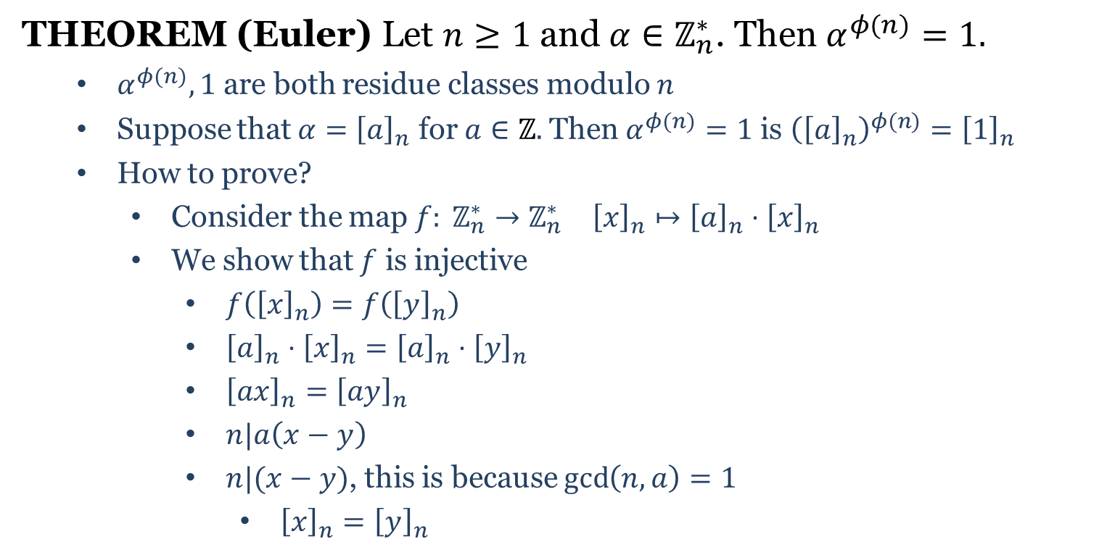
Euler’s Theorem
THEOREM (Euler) Let $n≥1$ and $α∈ℤ_{n}^{∗}$. Then $α^{φ(n)}=1.$
$α^{φ(n)}, 1$ are both residue classes modulo $n$
Suppose that $α={\left[a\right]}_{n}$ for $a∈ℤ.$ Then $α^{φ(n)}=1$ is ${\left({\left[a\right]}_{n}\right)}^{φ(n)}={\left[1\right]}_{n}$
How to prove?
Consider the map $f: ℤ_{n}^{∗}→ℤ_{n}^{∗}$ ${\left[x\right]}_{n}↦{\left[a\right]}_{n}⋅{\left[x\right]}_{n}$
We show that $f$ is injective
$f\left({\left[x\right]}_{n}\right)=f\left({\left[y\right]}_{n}\right)$
${\left[a\right]}_{n}⋅{\left[x\right]}_{n}={\left[a\right]}_{n}⋅{\left[y\right]}_{n}$
${\left[ax\right]}_{n}={\left[ay\right]}_{n}$
$n|a\left(x−y\right)$
$n|(x−y)$, this is because $\gcd\left(n,a\right)=1$
${\left[x\right]}_{n}={\left[y\right]}_{n}$

Slide 10
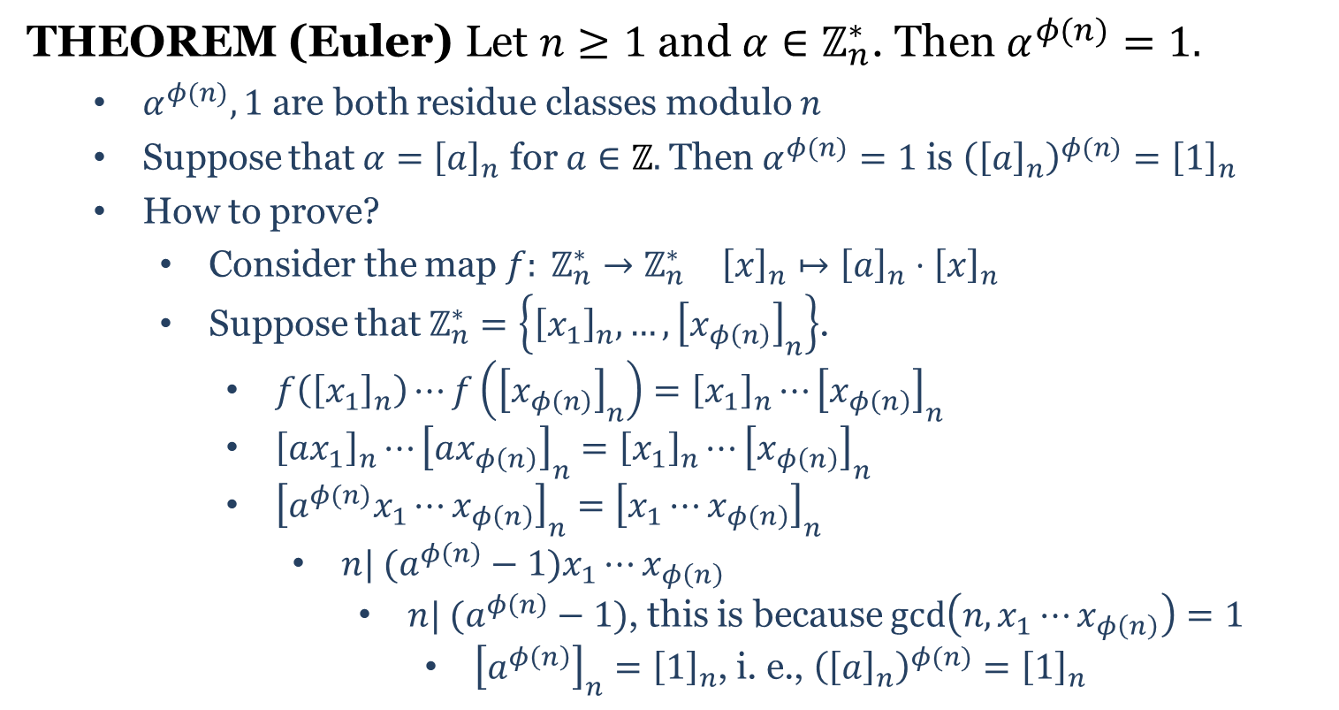
Euler’s Theorem
THEOREM (Euler) Let $n≥1$ and $α∈ℤ_{n}^{∗}$. Then $α^{φ(n)}=1.$
$α^{φ(n)}, 1$ are both residue classes modulo $n$
Suppose that $α={\left[a\right]}_{n}$ for $a∈ℤ.$ Then $α^{φ(n)}=1$ is ${\left({\left[a\right]}_{n}\right)}^{φ(n)}={\left[1\right]}_{n}$
How to prove?
Consider the map $f: ℤ_{n}^{∗}→ℤ_{n}^{∗}$ ${\left[x\right]}_{n}↦{\left[a\right]}_{n}⋅{\left[x\right]}_{n}$
Suppose that $ℤ_{n}^{∗}=\left\{{\left[x_{1}\right]}_{n},…,{\left[x_{φ\left(n\right)}\right]}_{n}\right\}$.
$f\left({\left[x_{1}\right]}_{n}\right)⋯f\left({\left[x_{φ\left(n\right)}\right]}_{n}\right)={\left[x_{1}\right]}_{n}⋯{\left[x_{φ\left(n\right)}\right]}_{n}$
${\left[ax_{1}\right]}_{n}⋯{\left[ax_{φ\left(n\right)}\right]}_{n}={\left[x_{1}\right]}_{n}⋯{\left[x_{φ\left(n\right)}\right]}_{n}$
${\left[a^{φ(n)}x_{1}⋯x_{φ\left(n\right)}\right]}_{n}={\left[x_{1}⋯x_{φ\left(n\right)}\right]}_{n}$
$n| (a^{φ\left(n\right)}−1)x_{1}⋯x_{φ\left(n\right)}$
$n| (a^{φ\left(n\right)}−1)$, this is because $\gcd\left(n,x_{1}⋯x_{φ\left(n\right)}\right)=1$
${\left[a^{φ\left(n\right)}\right]}_{n}={\left[1\right]}_{n}$, i. e., ${\left({\left[a\right]}_{n}\right)}^{φ(n)}={\left[1\right]}_{n}$

Slide 11
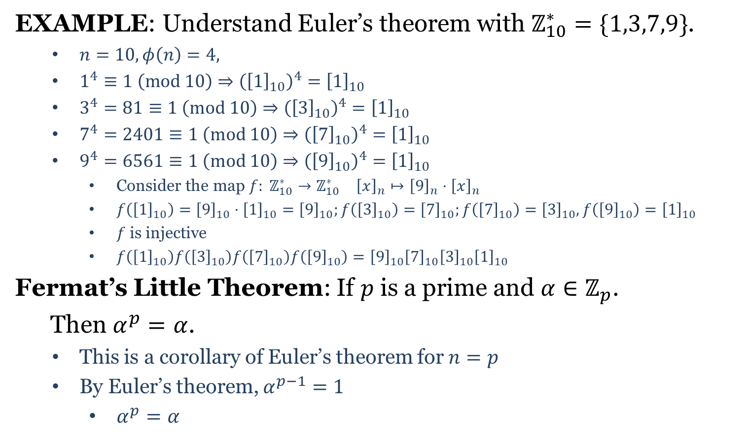
Fermat’s Little Theorem
EXAMPLE: Understand Euler’s theorem with $ℤ_{10}^{∗}=\{1,3,7,9\}$.
$n=10, φ\left(n\right)=4,$
$1^{4}≡1 \left(mod 10\right)⇒{\left({\left[1\right]}_{10}\right)}^{4}={\left[1\right]}_{10}$
$3^{4}=81≡1 \left(mod 10\right)⇒{\left({\left[3\right]}_{10}\right)}^{4}={\left[1\right]}_{10}$
$7^{4}=2401≡1 \left(mod 10\right)⇒{\left({\left[7\right]}_{10}\right)}^{4}={\left[1\right]}_{10}$
$9^{4}=6561≡1 \left(mod 10\right)⇒{\left({\left[9\right]}_{10}\right)}^{4}={\left[1\right]}_{10}$
Consider the map $f: ℤ_{10}^{∗}→ℤ_{10}^{∗}$ ${\left[x\right]}_{n}↦{\left[9\right]}_{n}⋅{\left[x\right]}_{n}$
$f\left({\left[1\right]}_{10}\right)={\left[9\right]}_{10}⋅{\left[1\right]}_{10}={\left[9\right]}_{10};f\left({\left[3\right]}_{10}\right)={\left[7\right]}_{10};f\left({\left[7\right]}_{10}\right)={\left[3\right]}_{10}, f\left({\left[9\right]}_{10}\right)={\left[1\right]}_{10}$
$f$ is injective
$f\left({\left[1\right]}_{10}\right)f\left({\left[3\right]}_{10}\right)f\left({\left[7\right]}_{10}\right)f\left({\left[9\right]}_{10}\right)={\left[9\right]}_{10}{\left[7\right]}_{10}{\left[3\right]}_{10}{\left[1\right]}_{10}$
Fermat’s Little Theorem: If $p$ is a prime and $α∈ℤ_{p}^{ }$.
Then $α^{p}=α$.
This is a corollary of Euler’s theorem for $n=p$
By Euler’s theorem, $α^{p−1}=1$
$α^{p}=α$

